Slide 1

Sandra E. Rodriguez-Cruz, Ph.D., ABC-F
SWGDRUG Secretariat
AAFS – Feb 26, 2016

Slide 2
History
1997 DEA and ONDCP co-sponsored formation of TWGDRUG
1999 First meeting in Washington, DC
1999 SWGDRUG name adopted
2001 1st Edition of Recommendations
2014 OSAC established (Seized Drugs)
2015 Version 7.1 of Recommendations (draft)

Slide 3
Mission
To improve the quality of the forensic examination of seized drugs and to respond to the needs of the forensic community by supporting the development of internationally accepted minimum standards, identifying best practices within the international community, and providing resources to help laboratories meet these standards.

Slide 4
Current Documents
SWGDRUG Recommendations v 7.1 (draft)
Supplemental Documents:
  SD-1 - A Code of Professional Practice for Drug Analysts
  SD-2 - Validation of Analytical Methods
  SD-3 - Examples of Measurement Uncertainty for Weight Determinations
  SD-4 - Examples of Measurement Uncertainty for Purity Determinations
  SD-5 - Reporting Examples

Slide 5
Current Resources
MS Library
  Over 2,300 compounds (Version 2.4 Dec 2015)
  All spectra collected using EI-MS systems
  Several formats (Agilent Tech., Shimadzu, etc.)
IR Library
  All spectra collected using FTIR-ATR system
  DEA Special Testing and Research Lab
  Several formats (Omnic, PE, etc.)
Drug Monographs
  Over 250 available
  DEA Special Testing and Research Lab

Slide 6
ASTM Documents
OSAC Seized Drugs Subcommittee has voted to forward the following SWGDRUG –developed documents to the OSAC Registry of Standards:
  E2329: Identification of Seized Drugs
  E2548: Sampling Seized Drugs for Qualitative and Quantitative Analysis – in revision
  E2326: Education and Training of Seized-Drug Analysts
  E2327: Quality Assurance of Laboratories Performing Seized-Drug Analysis

Slide 7
ASTM Documents
These SWGDRUG-developed documents will also be considered by OSAC Seized Drugs Subcommittee:
  E2549: Validation of Seized-Drugs Analytical Methods – in revision
  E2764: Uncertainty Assessment in the Context of Seized Drug Analysis – in revision
  E2882: Analysis of Clandestine Laboratory Evidence

Slide 8
2015 Summary
In-person meeting – June 2015
SWGDRUG Rec. v 7.1 – In revision
  Part IIIB
  Part IVB
Supplemental Documents:
  Validation of qualitative methods
  Uncertainty for net weight extrapolations

Slide 9
SWGDRUG Recommendations
Category A | Category B | Category C
IR | CE | Color Tests
MS | GC | Fluorescence
NMR | IMS | Immunoassay
Raman | LC | Melting Point
X-ray Diffractometry | Microcrystalline Tests | UV
 | Pharmaceutical ID
 | TLC
 | Cannabis only: Macro Examination Micro Examination

Slide 10
SWGDRUG Recommendations
Part IIIB – Drug Identification
  Categorization of analytical techniques
  Consideration of new technologies
  No changes to categories, but further guidance
  Address different operation modes and variations within a technique
  How their categorization can be affected

Slide 11
SWGDRUG Recommendations
Part IVB – Validation of Analytical Methods
  Clarification on performance characteristics that should be evaluated when validating a qualitative method
  Repeatability, accuracy, LOD, etc.
  Documentation needed for validation
  Examples (supplemental document):
    GC-MS drug screen
    Color test

Slide 12
Supplemental Document SD-6
Measurement Uncertainty for Net Weight or Unit Count Extrapolation
  Three (3) scenarios
        NW extrapolation based on non-statistical sampling of population
        NW extrapolation based on hypergeometric sampling of population
        Unit count extrapolation based on non-statistical sampling (direct NW)

Slide 13
SWGDRUG Document Process
Development
  Drafted by subcommittees
  Reviewed by core committee
  Public comments (60 days)
  Drafts revised, as needed
  Voted by core committee
Dissemination
  www.swgdrug.org

Slide 14
Future Directions
SWGDRUG meetings:
  Core committee (national & international)
  DEA – financial support
Provide resources:
  Recommendations
  Supplemental documents
  Libraries and monographs
Support the development of internationally accepted minimum standards for the analysis of seized drugs (OSAC)

Slide 15
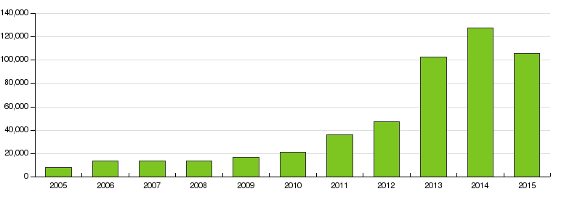
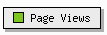
www.SWGDRUG.org

Slide 16
SWGDRUG Core Committee
DEA – Scott R. Oulton (Chair)**
SAFS – Christian Matchett (Vice Chair)**
DEA & AAFS – Dr. Sandra Rodriguez-Cruz¹**
MAFS – Richard Paulas**
MAAFS – vacancy
NEAFS – Tiffany Ribadeneyra**
NWAFS & CAC – Sandra Sachs**
SWAFS – Roger Schneider
Educator – Dr. Eric Person**
FBI – Pamela Reynolds
¹non-voting

Slide 17
SWGDRUG Core Committee
ASCLD – Garth Glassburg**
NIST – Karen Phinney
AFSN/IDWG – Dr. Angeline Yap Tiong Whei
AICEF – Dr. Adriano Maldaner
Australia – Catherine Quinn
Canada – Richard Laing
ENFSI – Dr. Michael Bovens
Germany – Dr. Udo Zerell
United Kingdom – Dr. Sylvia Burns
UNODC – Dr. Conor Crean

Slide 18
Thank You!
www.swgdrug.org
swgdrug@hotmail.com

