Slide 1

Mission:
To improve the quality of the forensic examination of seized drugs and to respond to the needs of the forensic community by supporting the development of internationally accepted minimum standards, identifying best practices within the international community, and providing resources to help laboratories meet these standards.

Slide 2
History
1997 DEA and ONDCP co-sponsored formation of the
Technical Working Group for the Analysis of Seized Drugs (TWGDRUG)
1999 Forensic scientists from the United States, England, Canada, Australia, Japan, Germany, the Netherlands, United Nations, international forensic organizations and academia were invited to meet in Washington, DC
1999 SWGDRUG name adopted
2001 1st edition of SWGDRUG Recommendations
2014 Version 7.0 of SWGDRUG Recommendations

Slide 3
Documents
Development
Documents are drafted by sub-committees
Drafts reviewed by core committee
Drafts posted on website for public comments (60 days)
Drafts revised as needed
Final documents voted on by core committee
Dissemination
WWW.SWGDRUG.ORG
Local, national and international meetings
Development of standards practices / guides via ASTM

Slide 4
SDO
SWGDRUG has brought most of its recommendations to ASTM. They have been adopted as internationally recognized standards/practices.
  ASTM Standard Guides or Practices:
  E2326: Education and Training of Seized-Drug Analysts
  E2327: Quality Assurance of Laboratories Performing Seized- Drug Analysis
  E2329: Identification of Seized Drugs
  E2548: Sampling Seized Drugs for Qualitative and Quantitative Analysis
  E2549: Validation of Seized-Drugs Analytical Methods
  E2764: Uncertainty Assessment in the Context of Seized Drug Analysis
    E2882: Analysis of Clandestine Laboratory Evidence

Slide 5
SWGDRUG
Current Documents:
    SWGDRUG Recommendations, Version 7.0 (Available August 14th, 2014)
    SD-1: A Code of Professional Practice for Drug Analysts
    SD-2: Validation of Analytical Methods
    SD-3: Examples of Measurement Uncertainty for
    Weight Determinations
    SD-4: Examples of Measurement Uncertainty for
    Purity Determinations
    SD-5: Reporting Examples
    Supplemental documents are intended to be a resource for those responsible for implementing SWGDRUG Recommendations.

Slide 6
2014
Summary:
  Last meeting – August 2014
  SWGDRUG Recommendations 7.0 – August 2014
  Supplemental Document SD-6 – In development
  SWGDRUG MS Library – Version 2.2 (October 2014)
  SWGDRUG IR Library – Version 1.1 (May 2014)
  Drug Monographs – More than 235 available
  NIST/OSAC – SWGDRUG role & future directions

Slide 7
2014
SWGDRUG Recommendations:
Version 7.0 – Available October 14th, 2014
Addition of PART III D – Methods of Analysis/ Analogue and Structural Class Determinations
        Purpose: Assessment of controlled substance analogue issue
        Public comment period: Spring 2013
        Contents: Emphasizes the need for analysts to fully understand how analogues and structural classes are legally defined in their jurisdiction before rendering opinions about the classification of a substance.

Slide 8
2014
Supplemental Document SD-6:
Measurement Uncertainty for Cases of Net Weight or Unit Count Extrapolation
Three (3) scenarios:
        NW extrapolation based on non-statistical sampling of population
        NW extrapolation based on hypergeometric sampling of population
        Unit count extrapolation based on non-statistical sampling (direct NW)

Slide 9
2014
SWGDRUG MS Library:
    Drugs and drug-related compounds:
          All spectra collected using EI-MS systems
          Use traceable RM to support identifications
    DISCLAIMER: Although SWGDRUG makes an effort to review the accuracy of spectra prior to entry, this library should only be used as an analytical tool.
    Library is available in several formats:
                NIST MSSEARCH (free), NIST Text, JCAMP
                Agilent Technologies, Shimadzu
    Over 2,200 compounds (Version 2.2 October 2014)
    Updated often to keep up with emerging trends
    Submissions from public are welcome

Slide 10
2014
SWGDRUG IR Library:
    Drugs and drug-related compounds:
          All spectra collected using FTIR-ATR system
          Using structurally confirmed reference materials
          DEA Special Testing and Research Laboratory
    Library is available in several formats:
                Omnic, Opus, Perkin Elmer, and JCAMP
    Over 150 compounds (Version 1.1 May 2014)
    Updated often to keep up with emerging trends

Slide 11
2014
Drug Monographs:
Purpose: Reference material verification
Contents: Detailed information and analytical data
Analyzed, verified and authenticated by DEA Special Testing and Research Laboratory
Availability:
      As of November 2012
      www.swgdrug.org
      Over 235 monographs currently available
  Prioritized based on community needs
  Partnered with Forendex

Slide 12
SWGDRUG
Current & Future Direction:
National Commission on Forensic Science:
  4 commissioners (past/current SWGDRUG members)
Organization of Scientific Area Committees (OSAC)
  5 SACs
  Chemistry and Instrumental Analysis SAC:
    Chair – Scott R. Oulton
6 Subcommittees
Controlled Substances Subcommittee:
    20 members
    7 current SWGDRUG members
    Chair – Sandra E. Rodriguez-Cruz

Slide 13
SWGDRUG
Current & Future Direction:
SWGDRUG meetings:
          Core committee (national & international)
          DEA financial support
SWGDRUG resources:
          Documents
          MS library
          IR library
          Drug monographs
          SWGDRUG website/e-mail:
          www.swgdrug.org
          swgdrug@hotmail.com

Slide 14
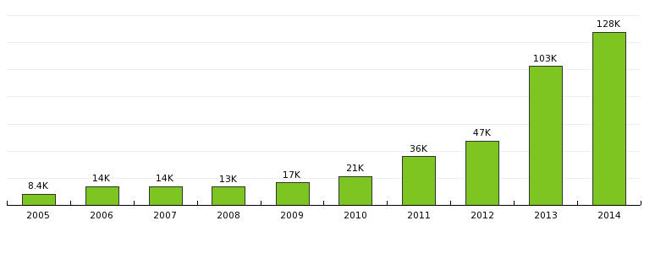
SWGDRUG
Website (2005-2014):
Page views
Updated January 4, 2015

Slide 15
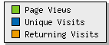
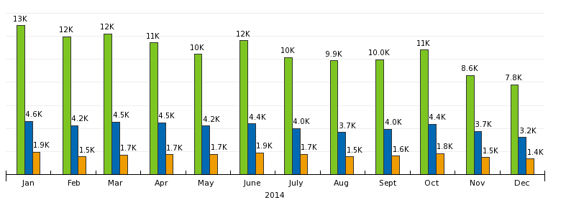
SWGDRUG
Website (2014):
Updated January 4, 2015

Slide 16
SWGDRUG
Core Committee:
  DEA & ASTM – Scott R. Oulton (Chair)**
  SAFS – Christian Matchett (Vice Chair)**
  DEA & AAFS – Dr. Sandra Rodriguez-Cruz¹**
  FBI – Pamela Reynolds
  ASCLD – Garth Glassburg**
  NIST – Karen Phinney
  NEAFS – Tiffany Ribadeneyra**
  Educators – Dr. Suzanne Bell & Dr. Eric Person**
  CAC & NWAFS – Sandra Sachs**
  MAFS – Richard Paulas**
  MAAFS – vacancy
  SWAFS – Roger Schneider
  Toxicology – vacancy
¹Secretariat
(non-voting)

Slide 17
SWGDRUG
Core Committee:
  Canada – Richard Laing
  United Kingdom – Dr. Sylvia Burns
  Australia – Catherine Quinn
  Germany – Dr. Udo Zerell
  ENFSI – Dr. Michael Bovens
  UNODC – Dr. Conor Crean
  AFSN/IDWG – Dr. Angeline Yap Tiong Whei
  AICEF – Dr. Adriano Maldaner

Slide 18
THANK YOU!
www.swgdrug.org

