Slide 1
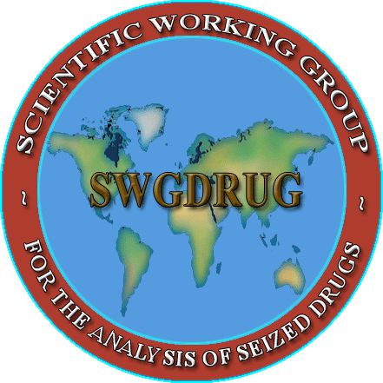
SWGDRUG
Mission:
To recommend minimum standards for the forensic examination of seized drugs and to seek their international acceptance

Slide 2
History
1997 DEA and ONDCP co-sponsored formation of the
Technical Working Group for the Analysis of Seized Drugs (TWGDRUG)
1999 Forensic scientists from the United States, England, Canada, Australia, Japan, Germany, the Netherlands, United Nations, international forensic organizations and academia were invited to meet in Washington, DC
1999 SWGDRUG name adopted
2001 1st edition of SWGDRUG Recommendations
2013 Version 6.1 of SWGDRUG Recommendations

Slide 3
Documents
Development
Documents are drafted by sub-committees
Drafts reviewed by core committee
Drafts posted on website for public comments (60 days)
Drafts revised as needed
Final documents voted on by core committee
Dissemination
WWW.SWGDRUG.ORG
Local, national and international meetings
Development of standards practices / guides via ASTM

Slide 4
SDO
SWGDRUG has brought most of its recommendations to ASTM. They have been adopted as internationally recognized standards/practices.
  ASTM Standard Guides or Practices:
  E2326: Education and Training of Seized-Drug Analysts
  E2327: Quality Assurance of Laboratories Performing Seized- Drug Analysis
  E2329: Identification of Seized Drugs
  E2548: Sampling Seized Drugs for Qualitative and Quantitative Analysis
  E2549: Validation of Seized-Drugs Analytical Methods
  E2764: Uncertainty Assessment in the Context of Seized Drug Analysis
    E2882: Analysis of Clandestine Laboratory Evidence

Slide 5
SWGDRUG
Current Documents:
    SWGDRUG Recommendations, Version 6.1 (Available November 1st, 2013)
    SD-1: A Code of Professional Practice for Drug Analysts
    SD-2: Validation of Analytical Methods
    SD-3: Examples of Measurement Uncertainty for
    Weight Determinations
    SD-4: Examples of Measurement Uncertainty for
    Purity Determinations
    SD-5: Reporting Examples
    Supplemental documents are intended to be a resource for those responsible for implementing SWGDRUG Recommendations.

Slide 6
2013
Accomplishments:
  SWGDRUG Recommendations – November 2013
  Supplemental Document SD-4 – January 2013
  SWGDRUG MS Library – Version 2.0 (January 2014)
  Drug Monographs – Available throughout 2013
  Analogue Document – Public comments (March-May)
  Training Resources – Available November 2013
  NIST/DEA Emerging Trends in Synthetic Drugs Workshop – April 30 – May 1, 2013

Slide 7
2013
SWGDRUG Recommendations:
Version 6.1 – Available November 1st, 2013
Revisions pertaining the use and verification of RMs
Addresses current difficulties obtaining and verifying new RMs
Minimum procedures for the verification of these materials
Alternative guidance for when newly emerging materials are encountered and verification is limited to structural elucidation procedures.

Slide 8
2013
Supplemental Document SD-4:
Examples of Measurement Uncertainty for Purity Determinations in Seized Drug Analysis
3 examples of purity analyses and how to estimate the uncertainty associated with results:
        Control chart method
        Using proficiency test and control chart data
        Single-case quantitation with replicated samplings

Slide 9
2013
SWGDRUG MS Library:
    Drugs and drug-related compounds:
          All spectra collected using EI-MS systems
          Use traceable RM to support identifications
    DISCLAIMER: Although SWGDRUG makes an effort to review the accuracy of spectra prior to entry, this library should only be used as an analytical tool.
    Library is available in several formats:
                NIST MSSEARCH (free), NIST Text, JCAMP
                Agilent Technologies, Shimadzu
    Over 1,950 compounds (Version 2.0 January 2014)
    Updated often to keep up with emerging trends
    Submissions from public are welcome

Slide 10
2013
Drug Monographs:
Purpose: Reference material verification
Contents: Detailed information and analytical data
Analyzed, verified and authenticated by DEA Special Testing and Research Laboratory
Availability:
      As of November 2012
      www.swgdrug.org
      Over 170 monographs currently available
  Prioritized based on community needs
  Partnered with Forendex

Slide 11
2013
Analogues:
Document:
          SWGDRUG Recommendations on Analogues and Structural Class Determinations
Purpose:
    Assessment of current controlled substance analogue issue
Public comment period: Spring 2013
Contents: Document emphasizes the need for analysts to fully understand how analogues and structural classes are legally defined in their jurisdiction before rendering opinions about the classification of a substance.

Slide 12
2013
Training Resources:
Documents:
    Training questions
    Subjects relevant to the analysis of seized drugs
    Color tests, IR, MS, separation techniques, etc.
Prepared by: Education and Training subcommittee
      Purpose:
      To be used as resources during the development or revision of laboratory training programs
Availability:
      November 2013
      www.swgdrug.org

Slide 13
SWGDRUG
Current & Future Projects:
Analogues subcommittee:
    Document revision and approval
Uncertainty subcommittee:
          Uncertainty of net weights (extrapolation cases)
      Other:
          Categories of Analytical techniques (Part III B)
          Category A, B, C
          Assessment of new techniques and modalities

Slide 14
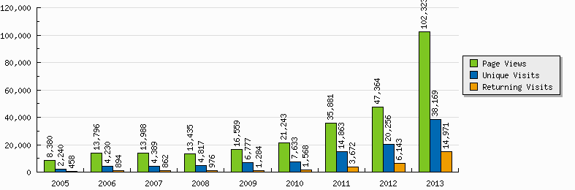
SWGDRUG
Website (2005-2013):
Updated December 30, 2013

Slide 15
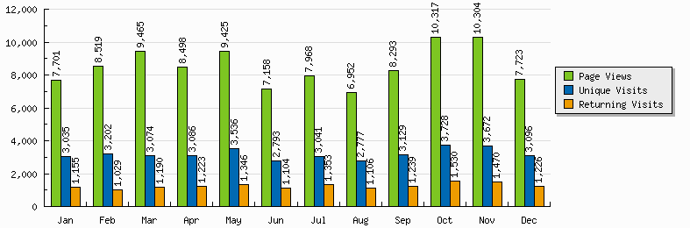
SWGDRUG
Website (2013):
Updated December 30, 2013

Slide 16
SWGDRUG
Core Committee:
  DEA – Scott R. Oulton (Chair)
  MAAFS – Linda C. Jackson (Vice Chair)
  DEA & AAFS – Dr. Sandra Rodriguez-Cruz*
  FBI – Pamela Reynolds
  ASCLD – Garth Glassburg
  NIST – Karen Phinney
  ASTM & NEAFS – vacancy
  Educators – Dr. Suzanne Bell & Dr. Eric Person
  CAC & NWAFS – vacancy
  MAFS – Richard Paulas
  SAFS – Christian Matchett
  SWAFS – vacancy
  Toxicology – Dr. Robert Powers
*Secretariat
(non-voting)

Slide 17
SWGDRUG
Core Committee:
  Canada – Richard Laing
  United Kingdom – Dr. Sylvia Burns
  Australia – Catherine Quinn
  Germany – Dr. Udo Zerell
  ENFSI – Dr. Michael Bovens
  UNODC – Dr. Conor Crean
  AFSN/IDWG – Dr. Angeline Yap Tiong Whei
  AICEF – Dr. Adriano Maldaner

Slide 18
THANK YOU!
www.swgdrug.org

