Slide 1

SWGDRUG
Scientific Working Group for the Analysis of Seized Drugs
Mission:
To recommend minimum standards for the forensic examination of seized drugs and to seek their international acceptance

Slide 2
SWGDRUG History
1997 DEA and ONDCP co-sponsored formation of the
Technical Working Group for the Analysis of Seized Drugs (TWGDRUG)
1999 Forensic scientists from the United States, England, Canada, Australia, Japan, Germany, the Netherlands, United Nations, international forensic organizations and academia were invited to meet in Washington, DC
1999 SWGDRUG name adopted
2001 1st edition of SWGDRUG Recommendations
2012 6th edition of SWGDRUG Recommendations

Slide 3
Document Development
Documents are drafted by sub-committees
Drafts reviewed by core committee
Drafts posted on website for public comments
(at least 60 days)
Drafts revised as needed
Final documents voted on by core committee
Document Dissemination
WWW.SWGDRUG.ORG
Local, national and international meetings
Development of standards / best practices / protocols via ASTM

Slide 4
Standard Development Organization
SWGDRUG has brought all of their recommendations (except ethics) to ASTM – They have been adopted and have become internationally recognized standards/practices.
  ASTM Standards:
  E2326-09: Standard Practice for Education and Training of Seized-
  Drug Analysts
  E2327-10: Standard Practice for Quality Assurance of Laboratories
  Performing Seized-Drug Analysis
  E2329-10: Standard Practice for Identification of Seized Drugs
  E2548-11: Standard Guide for Sampling Seized Drugs for Qualitative and Quantitative Analysis
  E2764-11: Standard Practice for Uncertainty Assessment in the
    Context of Seized Drug Analysis
    E2882-12: Standard Guide for the Analysis of Clandestine Laboratory Evidence

Slide 5
Current SWGDRUG Documents
    SWGDRUG Recommendations, Version 6.0 (Approved July 7, 2011)
    Supplemental Document SD-1: A Code of Professional Practice for Drug Analysts
    SD-2: Validation of Analytical Methods
    SD-3: Examples of Measurement Uncertainty for Weight Determinations
    SD-4: Examples of Measurement Uncertainty for Purity Determinations
    SD-5: Reporting Examples
    Supplemental documents are intended to be a resource for those responsible for implementing SWGDRUG Recommendations.

Slide 6
2012 Accomplishments
  AAFS 2012 Workshop – Weight Uncertainty (SD-3)
  Recommendations for Analysis of Clandestine Laboratory Samples – ASTM Standard Guide E2882
  SWGDRUG MS Library – multiple updates (v 1.7)
  Draft of Supplemental Document SD-4 finalized (Uncertainty for Purity Determinations)
Comment period: Jul-Sept 2012 Approved: Jan 2013
  Supplemental Document SD-5 finalized (Reporting Examples)
  Comment period: Apr-Jun 2012 Approved: Jul 2012
  Drug Monographs
          Available Nov 2012

Slide 7
SWGDRUG MS Library
    SWGDRUG has compiled a mass spectral library from a variety of sources, containing drugs and drug-related compounds
          All spectra collected using EI-MS systems
          Use traceable RM to support identifications
    DISCLAIMER: Although SWGDRUG makes an effort to review the accuracy of spectra prior to entry, this library should only be used as an analytical tool.
    SWGDRUG MS library is available in several formats:
                NIST MSSEARCH (free), NIST Text, JCAMP
                Agilent Technologies, Shimadzu
    Currently contains over 1,700 compounds (v.1.7 Jan 2013)
    Updated often to keep up with emerging trends
    Submissions from public are welcome

Slide 8
Supplemental Document SD-4
Examples of Measurement Uncertainty for Purity Determinations in Seized Drug Analysis
3 examples of purity analyses and how to estimate the uncertainty associated with results:
        Control chart method
        Using proficiency test and control chart data
        Single-case quantitation with replicated samplings

Slide 9
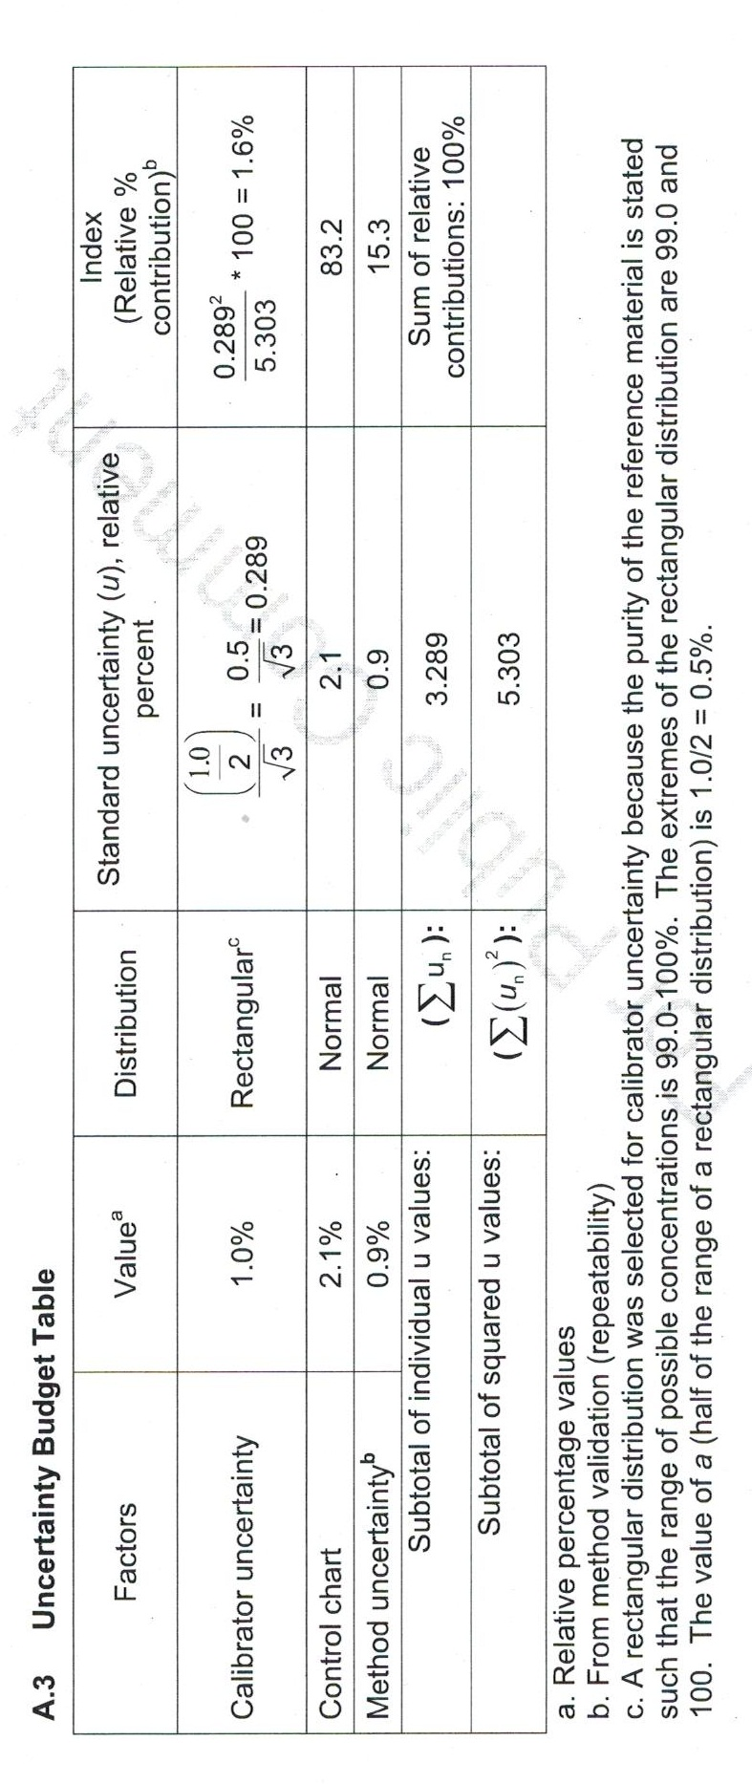
Supplemental Document SD-4
Ex. 1: Control Chart Method

Slide 10
Supplemental Document SD-4
Ex. 3: Using Replicate Samplings
Scenario:
      Laboratory where quantitation is not part of routine analysis
Replicates:
      6 samplings
      Homogeneity criteria
Analysis of QC samples:
Verify instrument/method performance
Accuracy criteria

Slide 11
Supplemental Document SD-5
Reporting Examples
Examples of laboratory reports that would fulfill SWGDRUG’s reporting recommendations
  Short and long versions
  Examples were revised after public comment period

Slide 12
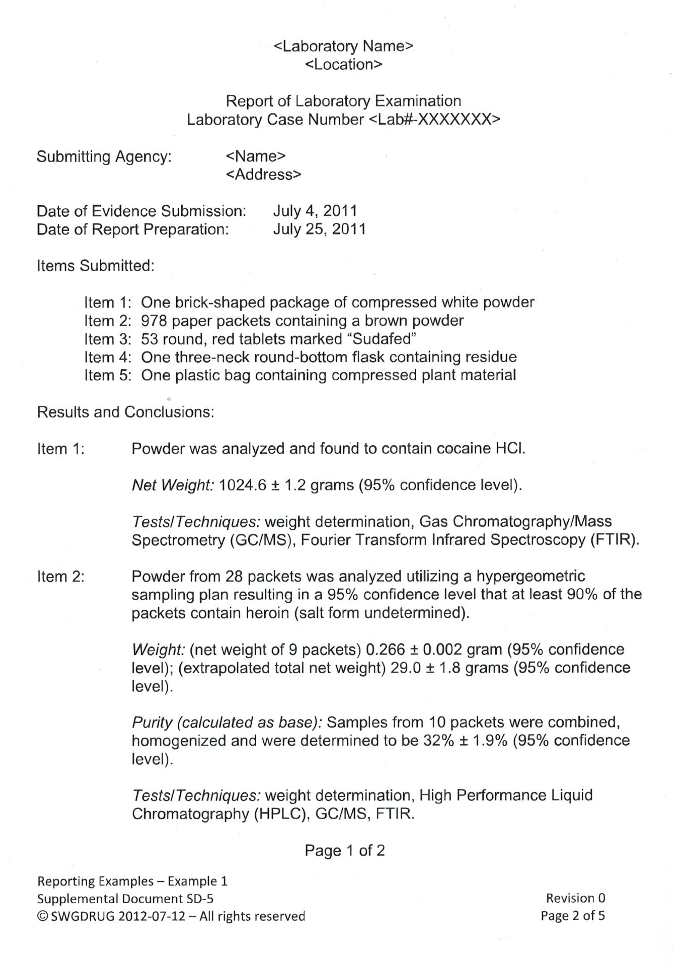
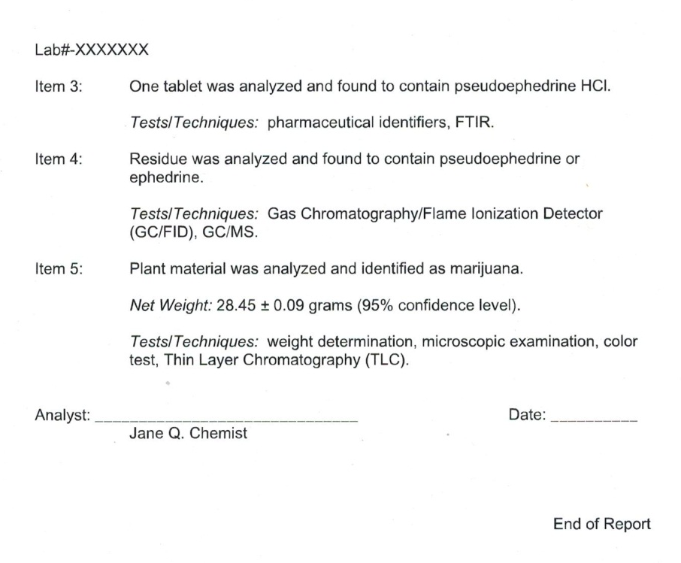
Supplemental Document SD-5

Slide 13
Drug Monographs
Purpose:
    Reference material verification
    Limited methodology
    Limitations
Peer reviewed (structural elucidation)
Availability:
      www.swgdrug.org
      November 2012
      2 monographs per week
  Prioritized based on community needs
  Partnered with Forendex

Slide 14
Current SWGDRUG Projects
Reference Materials Sub-committee
SWGDRUG Recommendations 6.1 (DRAFT)
Assessment of reference materials
Issues: availability, companies, structural elucidation, etc.
Public comments: until March 29, 2013
Analogues Sub-committee
  DRAFT document
  Addressing current issues regarding conclusions and opinions on analogues and structural class identifications

Slide 15
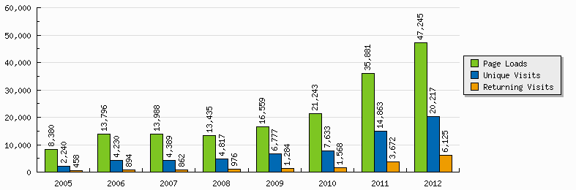
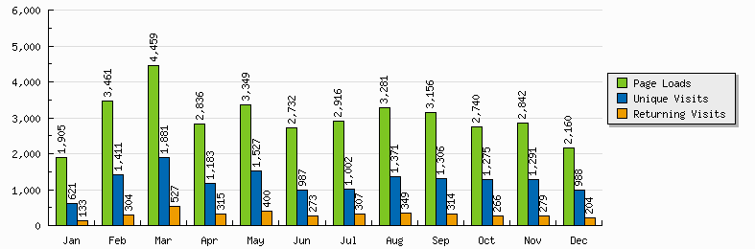
SWGDRUG Website
Updated December 30, 2012

Slide 16
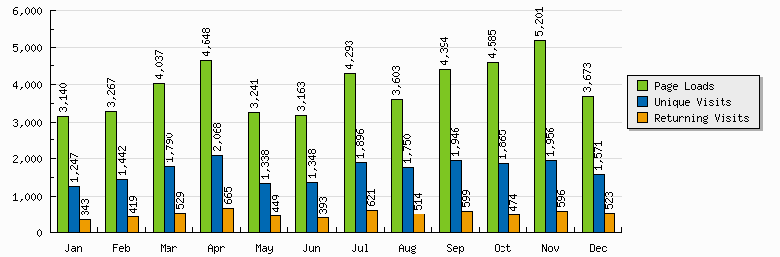
SWGDRUG Website
MS Library Update
MS Library Update
Drug
Monographs
2012
Updated December 30, 2012

Slide 17
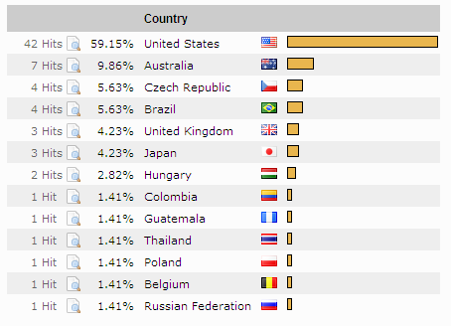
SWGDRUG Website Visitors
One-Day Sample: August 29, 2012

Slide 18
SWGDRUG Core Committee
  DEA – Scott R. Oulton (Chair)
  MAAFS – Linda C. Jackson (Vice Chair)
  DEA & AAFS – Dr. Sandra Rodriguez-Cruz*
  FBI - Pamela Reynolds
  ASCLD – Garth Glassburg
  NIST – Karen Phinney
  ASTM & NEAFS – vacancy
  Educators – Dr. Suzanne Bell & Dr. Eric Person
  CAC & NWAFS – vacancy
  MAFS – Richard Paulas
  SAFS – Christian Matchett
  SWAFS – vacancy
  Toxicology – Dr. Robert Powers
*Secretariat
(non-voting)

Slide 19
SWGDRUG Core Committee
  Canada – Richard Laing
  United Kingdom – Dr. Sylvia Burns
  Australia – Catherine Quinn
  Germany – Dr. Udo Zerell
  ENFSI – Dr. Michael Bovens
  UNODC – Dr. Conor Crean
  AFSN/IDWG – Dr. Angeline Yap Tiong Whei
  AICEF – Dr. Adriano Maldaner

Slide 20
SWGDRUG Vacancies
  Three (3) core committee positions:
      NWAFS / CAC
      NEAFS
      SWAFS
  Minimum 3-year commitment
  Appointment continues at discretion of Chair
  Not agency/affiliation appointment
  Application deadline: March 1st, 2013
  Visit www.swgdrug.org for more information regarding qualifications and application procedures

Slide 21
THANK YOU!
www.swgdrug.org

