Slide 1

2012 Update
SWGDRUG
Scientific Working Group for the Analysis of Seized Drugs
Mission: To recommend minimum standards for the forensic examination of seized drugs and to seek their international acceptance.
Sandra E. Rodriguez-Cruz
SWGDRUG Secretariat / DEA Southwest Laboratory

Slide 2
SWGDRUG History
1997
DEA and ONDCP co-sponsored formation of the Technical Working Group for the Analysis of Seized Drugs (TWGDRUG)
1999
Forensic scientists from the United States, England, Canada, Australia, Japan, Germany, the Netherlands, United Nations, international forensic organizations, and academia were invited to meet in Washington, DC
1999
SWGDRUG name adopted
2001
First edition of SWGDRUG Recommendations approved

Slide 3
Document Development
Documents are drafted by sub-committees
Drafts reviewed by core committee
Drafts posted on website for public comments
(at least 60 days)
Drafts revised as needed
Final documents voted on by core committee as per SWGDRUG bylaws

Slide 4
Document Dissemination
WWW.SWGDRUG.ORG
Local, national, and international meetings
Development of standards / best practices / protocols utilizing a standards development organization (SDO)

Slide 5
Standard Development Organization
SWGDRUG has brought all of their recommendations (except ethics) to ASTM
They have been adopted and have become internationally recognized standards/practices.
  ASTM Standards:
  E2326-09: Standard Practice for Education and Training of Seized-Drug Analysts
  E2327-10: Standard Practice for Quality Assurance of Laboratories Performing Seized-Drug Analysis

Slide 6
Standard Development Organization
  ASTM Standards (cont.):
  E2329-10: Standard Practice for Identification of Seized Drugs
  E2548-11: Standard Guide for Sampling Seized Drugs for Qualitative and Quantitative Analysis
  E2764-11: Standard Practice for Uncertainty Assessment in the Context of Seized Drug Analysis
    Exxxx-12: Standard Guide for the Analysis of Clandestine Laboratory Evidence

Slide 7
Current SWGDRUG Documents
    SWGDRUG Recommendations, Version 6.0 (Approved July 7, 2011)
    Supplemental Document SD-1: A Code of Professional Practice for Drug Analysts
    Supplemental Document SD-2: Validation of Analytical Methods
    Supplemental Document SD-3: Examples of Measurement Uncertainty for Weight Determinations
    Supplemental documents are intended to be a resource for those responsible for implementing SWGDRUG Recommendations. Supplemental documents are not all inclusive as there are many ways to implement the Recommendations. Comments and suggestions from the public are considered when drafting SWGDRUG supplemental documents.

Slide 8
2011 Accomplishments
January 2011: SWGDRUG Recommendations 5.1:
  Revisions to Part III A, Section 6, Reporting
  Revisions to Part IV A, Section 9.2, Report writing
July 2011: SWGDRUG Recommendations 6.0:
  Addition of Part III C: Methods of Analysis / Clandestine Laboratory Evidence
SWGDRUG Feedback Mechanism - to assess impact of Recommendations within community
Implementation of SWGDRUG mass spectral library
Revisions to Supplemental Document SD-3:
  Examples of Measurement Uncertainty for Weight Determinations

Slide 9
Part IIIA Sampling
    6 Reporting
    6.1 Statistically selected sample(s)
    Reporting statistical inferences for a population is acceptable when testing is performed on the statistically selected units. The language in the report must make it clear to the reader that the results are based on a sampling plan.
    6.2 Non-statistically selected sample(s)
    The language in the report must make it clear to the reader that the results apply to only the tested units. For example, 2 of 100 bags were analyzed and found to contain Cocaine.

Slide 10
Report Writing, Section 9.2
Reports issued by laboratories shall be accurate, clear, objective, and meet the requirements of the jurisdictions served. These reports shall include the following information:
  title of report
  identity and location of the testing laboratory
  unique case identifier (on each page)
  clear identification of the end of the report (e.g., Page 3 of 3)
  submitting agency
  date of receipt of evidence
  date of report
  descriptive list of submitted evidence
  identity and signature (or electronic equivalent) of analyst
  results / conclusions
  a list of analytical techniques employed
  sampling
  uncertainty.
If elements listed above are not included on the report, the laboratory shall have documented reasons (i.e. specific accreditation, customer or jurisdictional considerations), for not doing so.

Slide 11
Analysis of Clandestine Drug Laboratory Evidence
    Recommendations were developed in cooperation with the Clandestine Laboratory Investigating Chemists (CLIC) Association.
    This document provides guidance on the chemical analysis of items and samples related to suspected clandestine laboratories

Slide 12
SWGDRUG Requests Feedback
  To assess the value and utility of SWGDRUG recommendations in forensic science community
  Are SWGDRUG Recommendations considered in your laboratory?

Slide 13
SWGDRUG Feedback
  Has the laboratory defined its sampling strategy, taking into account the need for statistical and/or non-statistical sampling approaches?
39/42 (93%) respondents said “YES”
3/43 (7%) respondents are working toward meeting this recommendation
  Is uncertainty reported on qualitative findings?
YES – 4
NO – 31
No response – 17

Slide 14
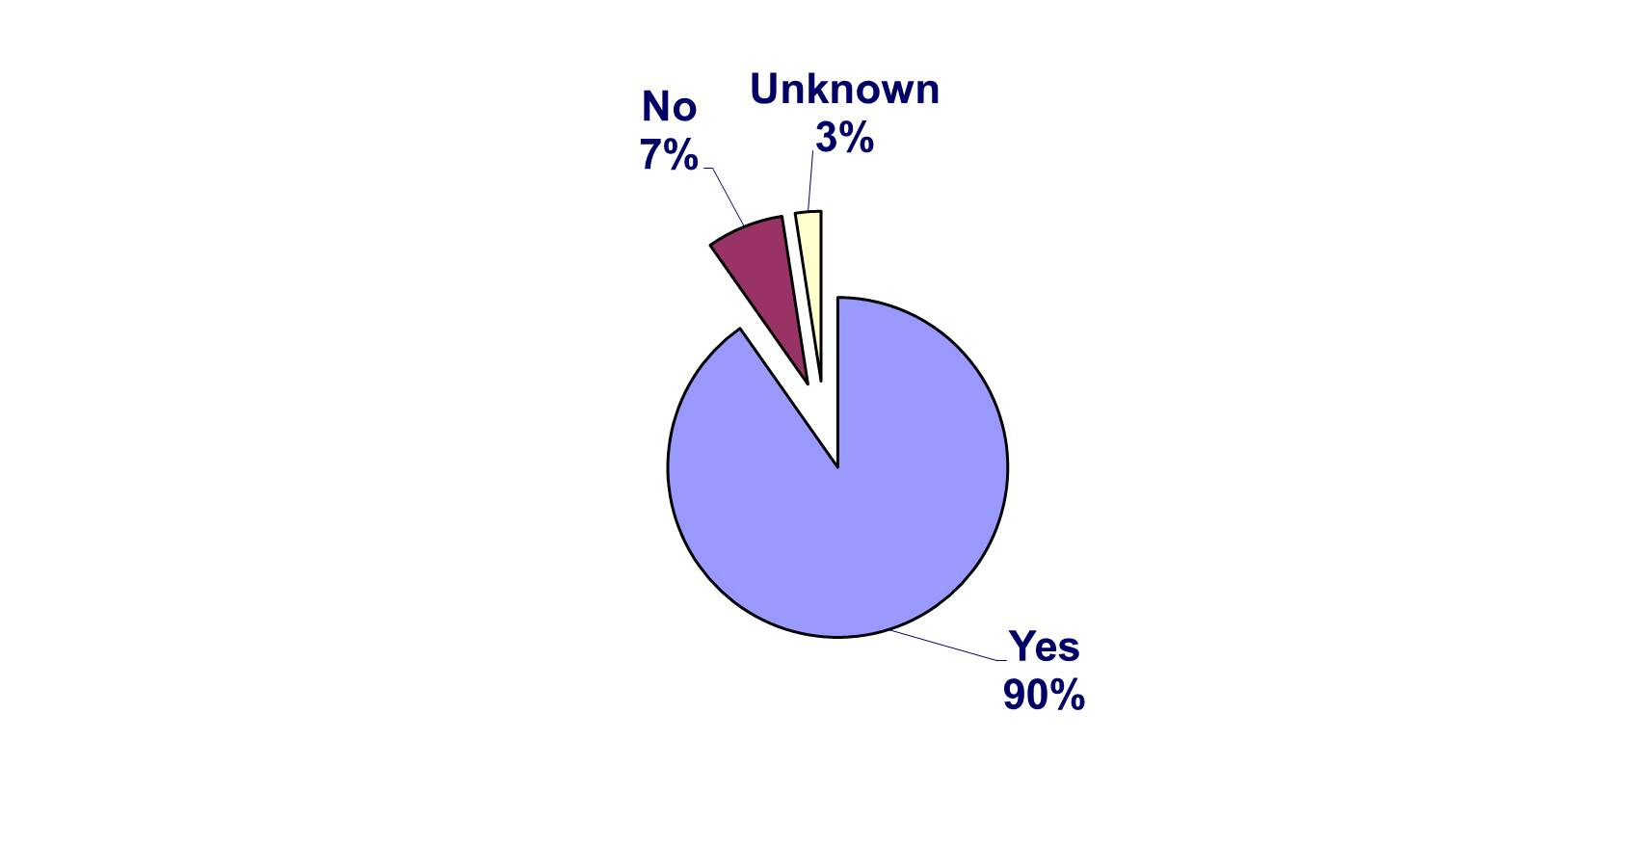
SWGDRUG Feedback
  Do analytical schemes employed for all drug samples, except Cannabis, include a Category A test?

Slide 15
SWGDRUG Feedback
  General Comments
        “SWGDRUG is an excellent resource that is dynamic in addressing future concerns.”
        “Guidelines for clan labs were a good addition.”
        “I like SWGDRUG pages and documents, learned a lot from this source.”
        “…continue with library GC-MS”
        …reporting…

Slide 16
SWGDRUG MS Library
    Compilation of mass spectral data from various sources
          EI-MS spectra of drugs & related compounds
    DISCLAIMER: Although SWGDRUG makes an effort to review the accuracy of spectra prior to entry, this library should only be used as an analytical tool.
        Use traceable RMs to support identifications
    SWGDRUG MS library is available in several formats:
                NIST MSSEARCH (free), NIST Text, JCAMP
                Agilent Technologies, Shimadzu
    Currently contains over 1,450 compounds
    Routine updates to keep up with emerging trends
    Submissions from public are welcome

Slide 17
Supplemental Document SD-3
This draft document was revised as a result of input received from the community and professional statisticians
Further explains approach in regards to correlations and assumptions

Slide 18
Current SWGDRUG Projects
Supplemental Document SD-4
(Uncertainty Subcommittee)
Ex. of measurement uncertainty for purity analyses
  Multiple approaches illustrated
  To be released for public comments on July 2012
Development of Reporting Examples
(Reporting Subcommittee)
Examples of laboratory reports that would fulfill SWGDRUG’s reporting recommendations
  Short & long versions

Slide 19
Current SWGDRUG Projects
Development of Internet Resource Page
(Education and Training Subcommittee)
Development of training resource page for the forensic community
Knowledge, skills, and abilities
  Accessible via SWGDRUG website
  Links to open source training programs (i.e., VA Department of Forensic Science)

Slide 20
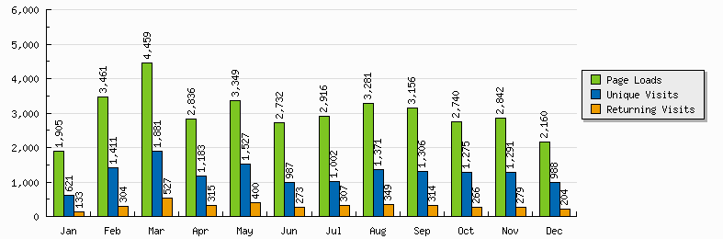
SWGDRUG Website
2011
Updated December 30, 2011

Slide 21
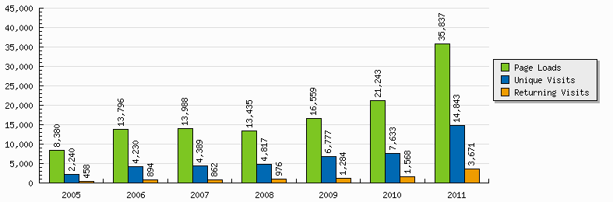
SWGDRUG Website
Updated December 30, 2011

Slide 22
SWGDRUG Core Committee
  DEA – Scott R. Oulton (Chair)
  DEA – Dr. Sandra Rodriguez-Cruz (Secretariat)*
  FBI - Pamela Reynolds
  ASCLD – Garth Glassburg
  NIST – Karen Phinney
  ASTM and NEAFS – Jack Mario
  Educators – Dr. Suzanne Bell & Dr. Eric Person
  CAC & NWAFS – Jerry Massetti
  MAFS – Richard Paulas
  MAAFS – Linda Jackson
  SAFS – Christian Matchett
  SWAFS – Scott Vajdos
  Toxicology – Dr. Robert Powers
*non-voting

Slide 23
SWGDRUG Core Committee
  Canada – Richard Laing
  United Kingdom – Dr. Sylvia Burns
  Australia – Catherine Quinn
  Germany – Dr. Udo Zerell
  ENFSI – Dr. Michael Bovens
  UNODC – Dr. Conor Crean
  AFSN/IDWG – Dr. Angeline Yap Tiong Whei
  AICEF – Dr. Adriano Maldaner

Slide 24
QUESTIONS?
Sandra E. Rodriguez-Cruz
swgdrug@hotmail.com
www.swgdrug.org

