Slide 1

SWGDRUG
Scientific Working Group for the Analysis of Seized Drugs
Scott R. Oulton, Chair

Slide 2
Overview
SWGDRUG history
In January 2011, the core committee:
  Approved SWGDRUG Recommendations 5.1
  Implemented mass spectral library
  Proposed a new document – Analysis of Clandestine Drug Laboratory Evidence
  Proposed revision to Supplemental Document SD-3
  Developed a new survey to assess impact of SWGDRUG Recommendations
Current work projects and future topics

Slide 3
SWGDRUG History
1997: DEA and ONDCP co-sponsored formation of the Technical Working Group for the Analysis of Seized Drugs (TWGDRUG)
1999: Forensic scientists from the United States, England, Canada, Australia, Japan, Germany, the Netherlands, United Nations, international forensic organizations and academia were invited to meet in Washington, DC.
1999: SWGDRUG name adopted
2001: First edition of SWGDRUG Recommendations approved

Slide 4
SWGDRUG Mission
To recommend minimum standards for the forensic examination of seized drugs and to seek their international acceptance.

Slide 5
SWGDRUG Document Development
Documents drafted by sub-committee
Drafts reviewed by core committee
Drafts posted on website
Posted at least 60 days for public comments
Drafts revised as needed
Final documents voted on by core committee as per SWGDRUG bylaws

Slide 6
SWGDRUG Subcommittees
Education and Training
Editorial/Communications and Reporting
Uncertainty
Clandestine Laboratory Analysis
Glossary

Slide 7
Document Dissemination
SWGDRUG communicates work products via:
www.swgdrug.org
Presentations at local, national and international meetings
Development of standards/best practices/protocols utilizing a standards development organization

Slide 8
Core Committee

Slide 9
Core Committee
  DEA – Scott Oulton (Chair)
  DEA – Dr. Sandra Rodriguez-Cruz (Secretariat)*
  FBI - Eileen Waninger (Pamela Reynolds)
  ASCLD – Garth Glassburg
  NIST – Susan Ballou (Karen Phinney)
  ASTM and NEAFS – Jack Mario
  Educator – Dr. Suzanne Bell
  Educator – Dr. Eric Person
*non-voting

Slide 10
Core Committee
  CAC & NWAFS – Jerry Massetti
  MAFS – Richard Paulas
  MAAFS – Linda Jackson
  SAFS – Christian Matchett
  SWAFS – Scott Vajdos
  Toxicology – Dr. Robert Powers

Slide 11
Core Committee
  Canada – Richard Laing
  United Kingdom – Dr. Sylvia Burns
  Australia – Catherine Quinn
  Germany – Dr. Udo Zerell
  ENFSI – Dr. Michael Bovens
  UNODC – Dr. Iphigenia Naidis
  AFSN/IDWG – Dr. Angeline Yap Tiong Whei

Slide 12
SWGDRUG Recommendations

Slide 13
SWGDRUG Recommendations
The public comment period regarding the proposed report writing change ended in September 2010
Comments/suggestions from public were considered
Current version: 5.1, 2011-01-27 contains approved recommendations from the working group

Slide 14
Report Writing 9.2
Reports issued by laboratories shall be accurate, clear, objective, and meet the requirements of the jurisdictions served. These reports shall include the following information:
title of report
identity and location of the testing laboratory
unique case identifier (on each page)
clear identification of the end of the report (e.g., Page 3 of 3)
submitting agency
date of receipt of evidence
date of report
descriptive list of submitted evidence
identity and signature (or electronic equivalent) of analyst
results / conclusions
a list of analytical techniques employed
sampling
uncertainty.
If elements listed above are not included on the report, the laboratory shall have documented reasons (i.e. specific accreditation, customer or jurisdictional considerations), for not doing so.
Notes:
14

Slide 15
Part IIIA Sampling
    6 Reporting
    6.1 Statistically selected sample(s)
    Reporting statistical inferences for a population is acceptable when testing is performed on the statistically selected units. The language in the report must make it clear to the reader that the results are based on a sampling plan.
    6.2 Non-statistically selected sample(s)
    The language in the report must make it clear to the reader that the results apply to only the tested units. For example, 2 of 100 bags were analyzed and found to contain Cocaine.

Slide 16
SWGDRUG Mass Spectral Library

Slide 17
MS Library
    SWGDRUG has compiled a mass spectral library from a variety of sources, containing drugs and drug-related compounds
    All spectra were collected using EI-MS systems.
    DISCLAIMER: Although SWGDRUG makes an effort to review the accuracy of spectra prior to entry, this library should only be used as an analytical tool.
      Use traceable reference materials to support identifications of drugs

Slide 18
MS Library
    The SWGDRUG library is available in two formats:
      NIST MSSEARCH program
        Software available free of charge on internet
      Agilent Technologies
    Currently contains 1371 compounds
    The library will be updated often to keep up with emerging trends
    Submissions are welcome

Slide 19
Analysis of Clandestine Drug Laboratory Evidence

Slide 20
Analysis of Clan Lab Evidence
    In cooperation with Clandestine Laboratory Investigating Chemists (CLIC) a draft recommendation was approved for public comment
      The comment period expires May 20, 2011
    This draft document provides guidance on the chemical analysis of items and samples related to suspected clandestine laboratories
    There are many analytical schemes that can be utilized – no table of tests as in Part IIIB

Slide 21
Supplemental Documents

Slide 22
Supplemental Documents
    Intended to be a resource for those responsible for implementing SWGDRUG Recommendations
    Not all inclusive; many ways to implement Recommendations
    Purpose is to provide examples to be used in conjunction with SWGRUG Recommendations
    Comments/suggestions from public considered

Slide 23
Current Supplemental Documents
    Supplemental Document SD-1
    A Code of Professional Practice for Drug Analysts
    Supplemental Document SD-2
    Quality Assurance/Validation of Analytical Methods
    Supplemental Document SD-3
    Examples of Measurement Uncertainty for Weight Determinations

Slide 24
Supplement Document SD-3 Revision
This draft document was revised as a result of input received from the community and professional statisticians
  Further explains approach in regards to correlations and assumptions
Will be posted on website soon to solicit input from forensic science community until May 20, 2011

Slide 25
Pending Supplemental Document
Supplemental Document SD-4 - Examples of Measurement Uncertainty for Purity Determinations
  Contains several examples of estimating measurement uncertainty for purity determinations (e.g., bottom up, top down)
  Currently being drafted and expected to be released for public comment by July 2011

Slide 26
Feedback Mechanism

Slide 27
SWGDRUG Feedback
Soliciting Feedback
  To determine the extent in which recommendations are being implemented within the forensic science community
  With feedback, we can assess the value and utility of the SWGDRUG recommendations
  Feedback questions were approved by core committee January 2011
  Link on website directing to www.surveymonkey.com
  Accepting feedback until June 30, 2011

Slide 28
Seeking International Acceptance

Slide 29
Standard Developing Organization
SWGDRUG has brought all of their recommendations to the American Society for Testing and Materials (ASTM)
  Except ethics
All SWGDRUG recommendations have been adopted by ASTM and have become internationally recognized standards/practices

Slide 30
ASTM DOCUMENTS
(SWGDRUG-origin)
E2326-09 Standard Practice for Education and Training of Seized-Drug Analysts
E2327-10 Standard Practice for Quality Assurance of Laboratories Performing Seized-Drug Analysis
E2329-10 Standard Practice for Identification of Seized Drugs
E2548-07 Standard Guide for Sampling Seized Drugs for Qualitative and Quantitative Analysis
Pending Uncertainty Recommendations

Slide 31
Education and Training Subcommittee

Slide 32
Development of Training Program
SWGDRUG is working with ENFSI-DWG to develop an outline containing core competencies
  Anticipated completion May 2011
Phase 1 - Provide resources to community
  Publish/Hyperlink to outline
  Hyperlink to open source training programs (i.e., Virginia Department of Forensic Science)
Phase 2 – Continue development of on-line training program

Slide 33
SWGDRUG Website

Slide 34
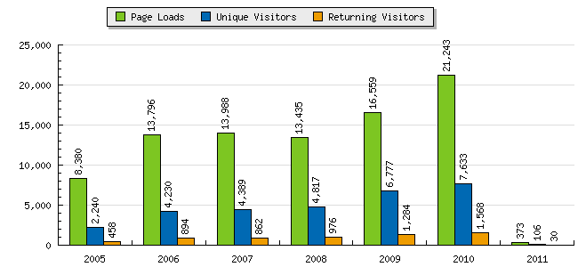
SWGDRUG Website
(2005-2010)

Slide 35
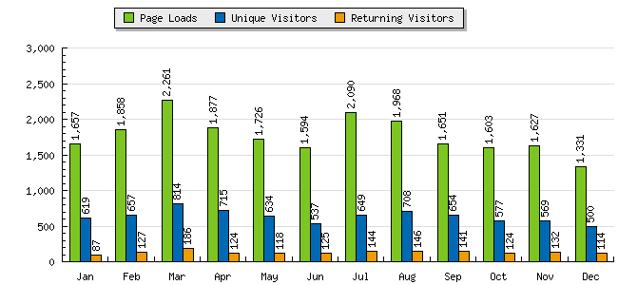
SWGDRUG Website
(2010)

Slide 36
www.swgdrug.org

