Slide 1

SWGDRUG 2017 Update
&
A Discussion on
Drug Analysis Techniques
and A-B-C Categorization
Sandra E. Rodriguez-Cruz, Ph.D., ABC-F
SWGDRUG Secretariat
AAFS - February 16, 2017

Slide 2
History
1997 DEA & ONDCP co-sponsored TWGDRUG
1999 First meeting in Washington, DC
1999 SWGDRUG name adopted
2001 1st Edition of Recommendations
2014 OSAC established (Seized Drugs)
2016 Version 7.1 of Recommendations
2017 20th Anniversary

Slide 3
Mission
To improve the quality of the forensic examination of seized drugs and to respond to the needs of the forensic community by supporting the development of internationally accepted minimum standards, identifying best practices within the international community, and providing resources to help laboratories meet these standards.

Slide 4
Current Documents
SWGDRUG Recommendations v 7.1
Supplemental Documents:
  SD-1: A Code of Professional Practice for Drug Analysts
  SD-2: Validation of Analytical Methods
  SD-3: Examples of Measurement Uncertainty for Weight Determinations
  SD-4: Examples of Measurement Uncertainty for Purity Determinations
  SD-5: Reporting Examples
  SD-6: Examples of Measurement Uncertainty for Extrapolations of Net Weight and Unit Count

Slide 5
Current Resources
MS Library
  Over 2,300 compounds (Version 3.1 November 29, 2016)
  All spectra collected using EI-MS systems
  Several formats (Agilent Tech., Shimadzu, etc.)
IR Library
  All spectra collected using FTIR-ATR system
  DEA Special Testing and Research Lab
  Several formats (Omnic, PE, etc.)
Drug Monographs
  Over 250 available
  DEA Special Testing and Research Lab

Slide 6
ASTM Documents
OSAC Seized Drugs Subcommittee has voted to forward the following SWGDRUG –developed documents to the OSAC Registry of Standards:
  E2329: Identification of Seized Drugs
  E2548: Sampling Seized Drugs for Qualitative and Quantitative Analysis
  E2326: Education and Training of Seized-Drug Analysts
  E2327: Quality Assurance of Laboratories Performing Seized-Drug Analysis
  E2882: Analysis of Clandestine Laboratory Evidence

Slide 7
ASTM Documents
These SWGDRUG-developed documents will also be considered by OSAC Seized Drugs Subcommittee:
  E2549: Validation of Seized-Drugs Analytical Methods – in revision
  E2764: Uncertainty Assessment in the Context of Seized Drug Analysis – in revision

Slide 8
2016 Summary
In-person meeting – June 2016
SWGDRUG Recommendations
  Version 7.1
Supplemental Documents:
  Finalized SD-6
In-progress:
  Validation of qualitative methods

Slide 9
Supplemental Document SD-6
Measurement Uncertainty for Extrapolation of Net Weight and Unit Count
  Three (3) scenarios
        NW extrapolation based on non-statistical sampling of population
        NW extrapolation based on hypergeometric sampling of population
        Unit count extrapolation based on non-statistical sampling (direct NW)

Slide 10
SWGDRUG (in-progress)
Part IVB – Validation of Analytical Methods
  Clarification on performance characteristics that should be evaluated when validating a qualitative method
  Repeatability, accuracy, LOD, etc.
  Documentation needed for validation
  Examples (supplemental document):
    GC-MS drug screen
    Color test

Slide 11
Future Directions
SWGDRUG meetings:
  Core committee (national & international)
  DEA – financial support
Provide resources:
  Recommendations
  Supplemental documents
  Libraries and monographs
Dissemination
  www.swgdrug.org
Support the development of internationally accepted minimum standards for the analysis of seized drugs (OSAC)

Slide 12
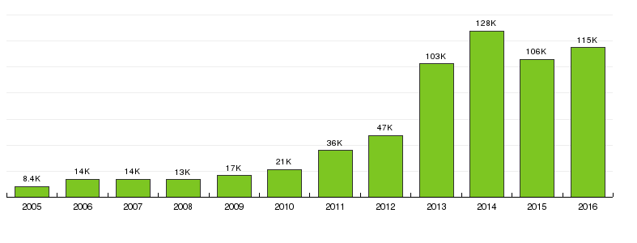
www.SWGDRUG.org
Visitors

Slide 13
Drug Analysis Techniques
and
A-B-C Categorization

Slide 14
SWGDRUG Recommendations
Category A | Category B | Category C
IR | CE | Color Tests
MS | GC | Fluorescence
NMR | IMS | Immunoassay
Raman | LC | Melting Point
X-ray Diffractometry | Microcrystalline Tests | UV
 | Pharmaceutical ID
 | TLC
 | Cannabis only: Macro Examination Micro Examination
PART III B - Methods of Analysis/Drug Identification

Slide 15
SWGDRUG Categories A-B-C:
Categorization is based on maximum potential discriminating power.
Depends on instrument design and operating conditions.
  Discriminating power may be diminished
  Cat. A → Cat. B or C
Emphasis on the result, not the technique.
  It is not the act of using a technique; it is the properties of the result obtained

Slide 16
SWGDRUG: Discriminating Power
The ability of a method to distinguish the analyte of interest from other closely related compounds.
  i.e. Analyte vs False Positives
Must be examined during validation.
Method may generate similar results for a limited list of known (or theoretical) compounds.
Method will exclude vast majority of possible compounds.

Slide 17
SWGDRUG: Discriminating Power
Diminished discriminating power
Example: Mass Spectrometry
FullMS
RT:
0.34-0.63
AV:
6
NL:
6.38E6
T:
+ c ESI Full ms [ 50.00-550.00]
311.3
100
(M + H⁺)⁺
80
60
Relative Abundance
40
312.3
20
0
50
100
150
200
250
300
350
400
450
500
550
m/z

Slide 18
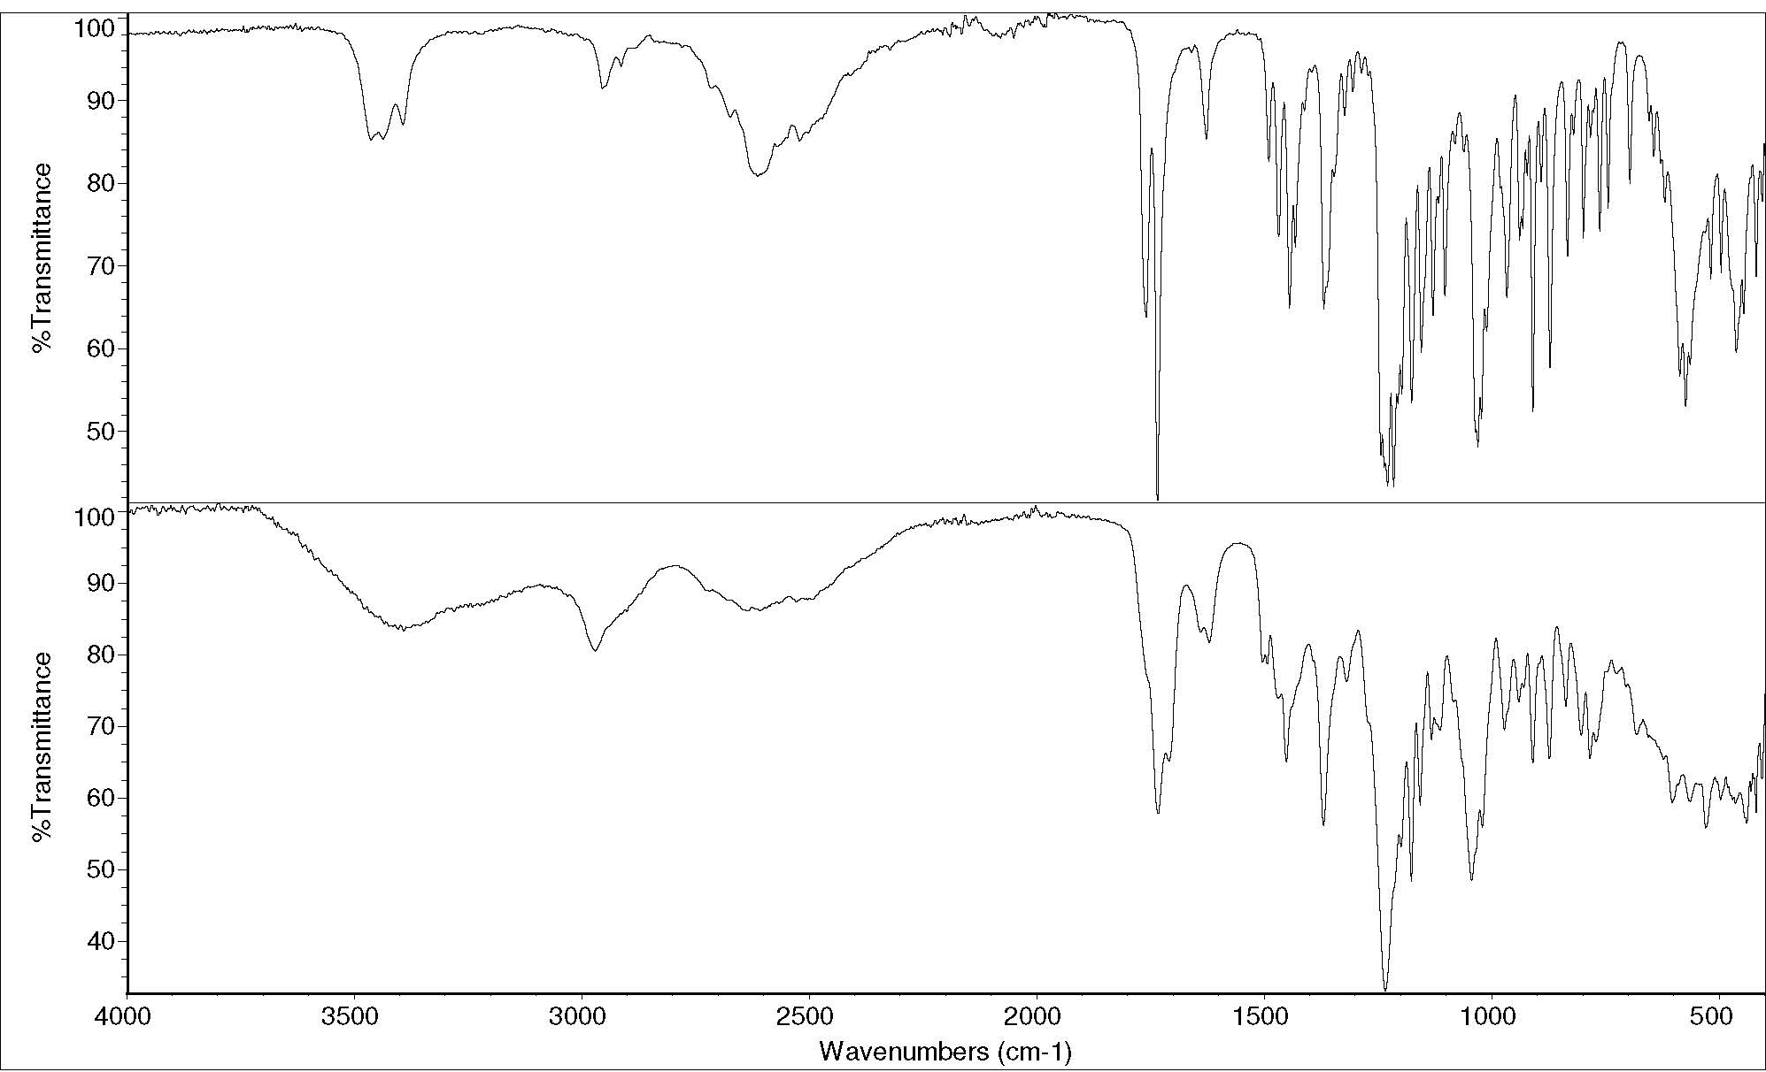
SWGDRUG: Discriminating Power
Diminished discriminating power
Example: Infrared Spectroscopy
Heroin HCl
Heroin HCl

Slide 19
SWGDRUG Categories A-B-C:
Category A
  Provides molecular structure information
  Theoretical relation between the molecular structure of the analyte and the observed data
  Predictability – Expert analyst can predict/explain spectral changes
Category B
  Does not provide molecular structure information
  Limited predictability (polarity, retention, etc.)
Category C
  Significant interferences (false positives)

Slide 20
SWGDRUG Recommendations
Minimum standards for identification
Two different tests:
  Cat. A and Cat. B or C
  2 Cat. B and Cat. C
Minimum standard may not be sufficient for identification of all substances:
  Method validation
  Analytical scheme design
  2 Cat. A and Cat. B OR 3 Cat. B
* SWGDRUG Recommendations v. 7.1, PART IIIB.4

Slide 21
Correct Identifications:
Will depend on:
  Appropriate analytical scheme
  Competence of analyst
Analytical Scheme:
Based on validated methods:
  Recognized/documented limitations
Will depend on:
  Substance(s) of interest
  Jurisdictional requirements
* SWGDRUG Recommendations v. 7.1, PART IIIB.1

Slide 22
Analytical Scheme Design:
Will include:
  Combination of techniques/methods to overcome individual limitations
  Use of orthogonal techniques:
    Reduce the likelihood of false positives
  Test 2 or more portions:
    Corroboration of results
    Reduce possibility of contamination
    Address sample heterogeneity

Slide 23
Analytical Scheme Design:
State Jurisdiction
  Identification of Methamphetamine
    GC-MS
Federal Jurisdiction
  Identification of d-Methamphetamine HCl
  Over 80% purity?
    GC-MS
    IR Spectroscopy
    Chiral analysis
    Purity analysis

Slide 24
SWGDRUG Recommendations
Summary:
  A-B-C categorization
  Discriminating power
  Minimum standards for identification
  Analytical scheme design

Slide 25
SWGDRUG Core Committee
DEA – Scott R. Oulton (Chair)
SAFS – Christian Matchett (Vice Chair)
DEA & AAFS – Dr. Sandra Rodriguez-Cruz¹
MAFS – vacant
MAAFS – Juli Cruciotti
NEAFS – Tiffany Ribadeneyra
NWAFS & CAC – Dr. Sandra Sachs
SWAFS – Roger Schneider
Educator – Dr. Eric Person
FBI – vacant
¹non-voting

Slide 26
SWGDRUG Core Committee
ASCLD – Garth Glassburg
ASTM – Agnes Winokur
NIST – Dr. Karen Phinney
AFSN/IDWG – Dr. Angeline Yap Tiong Whei
AICEF – Dr. Adriano Maldaner
Australia – Catherine Quinn
Canada – Richard Laing
ENFSI – Dr. Michael Bovens
Germany – Dr. Udo Zerell
United Kingdom – Dr. Sylvia Burns
UNODC – Dr. Conor Crean

Slide 27
Thank You!
www.swgdrug.org
swgdrug@hotmail.com

